Slide 1
Intro to Accelerator Physics
Eric Prebys
Fermi National Accelerator Laboratory
NIU Phys 790 Guest Lecture

Slide 2
Relativity and Units
Some Handy Relationships
Basic Relativity
Units
For the most part, we will use SI units, except
Energy: eV (keV, MeV, etc) [1 eV = 1.6x10⁻¹⁹ J]
Mass: eV/c² [proton = 1.67x10⁻²⁷ kg = 938 MeV/c²]
Momentum: eV/c [proton @ β=.9 = 1.94 GeV/c]
These units make these relationships really easy to calculate

Slide 3
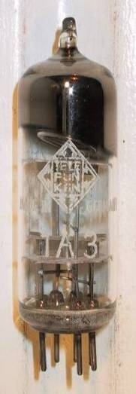
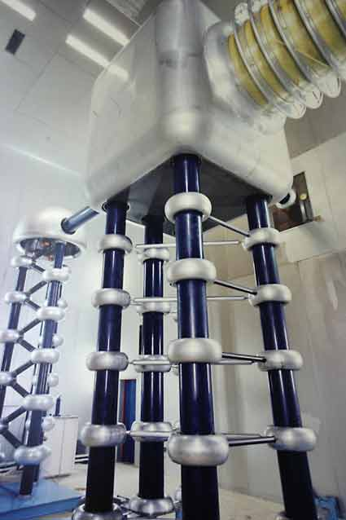
Man-made Particle Acceleration
The simplest accelerators accelerate charged particles through a static electric field. Example: vacuum tubes (or CRT TV’s)
Cathode
Anode
Limited by magnitude of static field:
- TV Picture tube ~keV - X-ray tube ~10’s of keV - Van de Graaf ~MeV’s
Solutions:
Alternate fields to keep particles in accelerating fields -> RF acceleration
Bend particles so they see the same accelerating field over and over -> cyclotrons, synchrotrons
FNAL Cockroft-Walton = 750 kV

Slide 4
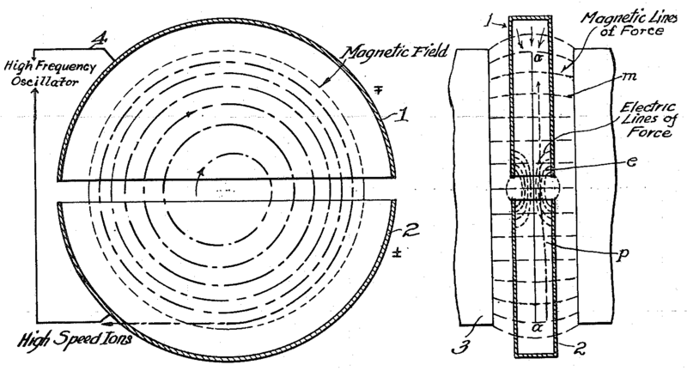
The Cyclotron (1930’s)
side view
top view
A charged particle (v<<c) in a uniform magnetic field will follow a circular path of radius
“Cyclotron Frequency”
For a proton:
Accelerating “DEES”

Slide 5
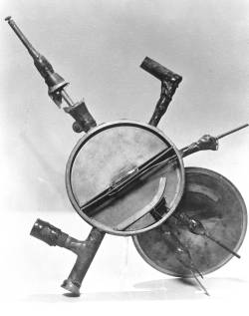
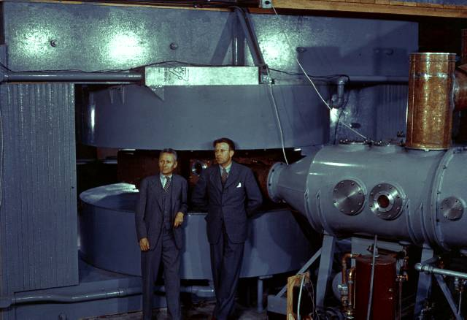
Round and Round We Go: the First Cyclotrons
~1930 (Berkeley)
Lawrence and Livingston
K=80KeV
1935 - 60” Cyclotron
Lawrence, et al. (LBL)
~19 MeV (D2)
Prototype for many

Slide 6
Beam “rigidity”
The relativistic form of Newton’s Laws for a particle in an electromagnetic field is:
A particle of unit charge in a uniform magnetic field will move in a circle of radius
side view
top view
constant for fixed energy
T-m²/s=V
units of eV in our usual convention
Beam “rigidity” = constant at a given momentum (even when B=0!)
Remember forever!

Slide 7
Application: Thin Lens Approximation and Magnetic “kick”
If the path length through a transverse magnetic field is short compared to the bend radius of the particle, then we can think of the particle receiving a transverse “kick” and it will be bent through small angle
In this “thin lens approximation”, a dipole is the equivalent of a prism in classical optics.

Slide 8
Synchrotrons
Cyclotrons have a fixed magnetic field
As the energy grows, so does the radius
Since the minimum radius is limited by the strength of the magnetic fields we can make, cyclotron get impractically large pretty quickly.
On the other hand, we just showed the trajectory of a particle will always depend on
If, as the particles accelerate, we scale all magnetic fields with the particle momentum, then the trajectories will be independent of energy!
➔”Synchrotron”*
*Edward McMillan, 1945

Slide 9
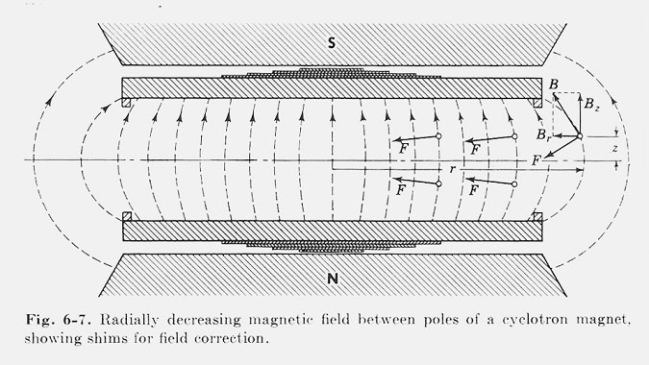
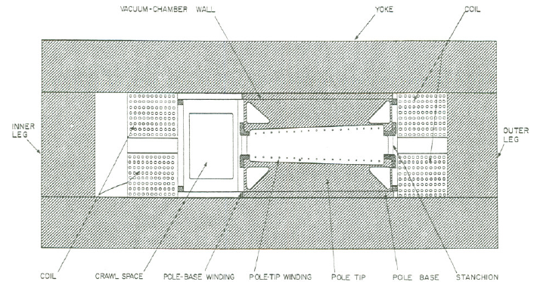
Weak Focusing
Cyclotrons relied on the fact that magnetic fields between two pole faces are never perfectly uniform.
This prevents the particles from spiraling out of the pole gap.
In early synchrotrons, radial field profiles were optimized to take advantage of this effect, but in any weak focused beams, the beam size grows with energy.
The highest energy weak focusing accelerator was the Berkeley Bevatron, which had a kinetic energy of 6.2 GeV
High enough to make antiprotons (and win a Nobel Prize)
It had an aperture 12”x48”!

Slide 10
Strong Focusing
Strong focusing utilizes alternating magnetic gradients to precisely control the focusing of a beam of particles
The principle was first developed in 1949 by Nicholas Christofilos, a Greek-American engineer, who was working for an elevator company in Athens at the time.
Rather than publish the idea, he applied for a patent, and it went largely ignored.
The idea was independently invented in 1952 by Courant, Livingston and Snyder, who later acknowledged the priority of Christophilos’ work.
Although the technique was originally formulated in terms of magnetic gradients, it’s much easier to understand in terms of the separate functions of dipole and quadrupole magnets.

Slide 11
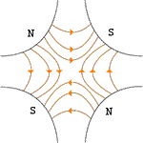
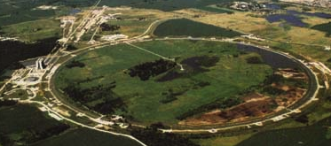

Combined Function vs. Separated Function
Strong focusing was originally implemented by building magnets with non parallel pole faces to introduce a linear magnetic gradient
=
+
dipole
quadrupole
CERN PS (1959, 29 GeV)
Later synchrotrons were built with physically separate dipole and quadrupole magnets. The first “separated function” synchrotron was the Fermilab Main Ring (1972, 400 GeV)
+
=
dipole
quadrupole
Fermilab
Strong focusing is also much easier to teach using separated functions, so we will…

Slide 12
Quadrupole Magnets as Lenses*
A positive particle coming out of the page off center in the horizontal plane will experience a restoring kick
focal length
*or quadrupole term in a gradient magnet

Slide 13
What About the Other Plane?
Defocusing!
Luckily, if we place equal and opposite pairs of lenses, there will be a net focusing regardless of the order.
➔pairs give net focusing in both planes -> “FODO cell”

Slide 14
A (first) Word about Coordinates and Conventions
We will work in a right-handed coordinate system with x horizontal, y vertical, and s along the nominal trajectory.
For now, assume bends are always in the x-s plane
Particle trajectory defined at any point in s by location in x,x’ or y,y’ “phase space”
unique initial phase space point ➔ unique trajectory

Slide 15
Transfer Matrices
The simplest magnetic “lattice” consists of quadrupoles and the spaces in between them (drifts). We can express each of these as a linear operation in phase space.
By combining these elements, we can represent an arbitrarily complex ring or line as the product of matrices.
Quadrupole:
Drift:

Slide 16
Transfer Matrix of a FODO cell
At the heart of every beam line or ring is the basic “FODO” cell, consisting of a focusing and a defocusing element, separated by drifts:
f
-f
L
L
Remember: motion is usually drawn from left to right, but matrices act from right to left!

Slide 17
Where we’re going…
It might seem like we would start by looking at beam lines and them move on to rings, but it turns out that there is no unique treatment of a standalone beam line
Depends implicitly in input beam parameters
Therefore, we will initially solve for stable motion in a ring.
Rings are generally periodic, made up of more or less identical cells
In addition to simplifying the design, we’ll see that periodicity is important to stability
The simplest rings are made of dipoles and FODO cells
Or “combined function magnets” which couple the two
Periodic “cell”
Our goal is to de-couple the problem into two parts
The “lattice”: a mathematical description of the machine itself, based only on the magnetic fields, which is identical for each identical cell
A mathematical description for the ensemble of particles circulating in the machine (“emittance”);

Slide 18
Quick Review of Linear Algebra
In the absence of degeneracy, an nxn matrix will have n “eigenvectors”, defined by:
Eigenvectors form an orthogonal basis
That is, any vector can be represented as a unique sum of eigenvectors
In general, there exists a unitary transformation, such that
Because both the trace and the determinant of a matrix are invariant under a unitary transformation:

Slide 19
Stability Criterion
We can represent an arbitrarily complex ring as a combination of individual matrices
We can express an arbitrary initial state as the sum of the eigenvectors of this matrix
After n turns, we have
Because the individual matrices have unit determinants, the product must as well, so

Slide 20
Stability Criterion (cont’d)
We can therefore express the eigenvalues as
However, if a has any real component, one of the solutions will grow exponentially, so the only stable values are
Examining the (invariant) trace of the matrix
So the general stability criterion is simply

Slide 21
Example
Recall our FODO cell
Our stability requirement becomes
L
L
f
-f

Slide 22
Twiss Parameterization
We can express the transfer matrix for one period as the sum of an identity matrix and a traceless matrix
The requirement that Det(M)=1 implies
We can already identify A=Tr(M)/2=cosμ. Setting the determinant of the second matrix to 1 yields the constraint
We can identify B=sinμ and write
Note that
So we can identify it with i=sqrt(-1) and write
“Twiss Parameters”
not Lorentz parameters!!
Normalization relationship ➔ only two independent
Remember this! We’ll see it again in a few pages

Slide 23
Calculating and Propagating the Lattice functions
If we know the transfer matrix or one period, we can explicitly calculate the lattice functions at the ends
If we then know the transfer matrix from point a to point b, M_{ba}, we can evolve the lattice functions from a to b

Slide 24
Calculating the Lattice functions (cont’d)
Using
We can now evolve the J matrix at any point as
Multiplying this mess out and gathering terms, we get

Slide 25
Examples
Drift of length L:
Thin focusing (defocusing) lens:

Slide 26
Moving on: Equations of Motion
For the moment, we will consider curvature in the horizontal (x) plane, with a reference trajectory established by the dipole fields.
General equation of motion (considering only transverse fields!)
We must solve this in the curving coordinate system
Messy but straightforward
Particle trajectory
Reference trajectory
s is motion along nominal trajectory
Transverse acceleration = γ doesn’t change!

Slide 27
Equations of Motion (cont’d)
We will keep only the first order terms in the magnetic field
Expanding in the rotating coordinate system and keeping first order terms…
Transform independent variable from t to s
s is measured along nominal trajectory, v_{s} measured along actual trajectory
Looks “kinda like” a harmonic oscillator
“centripetal” term

Slide 28
Comment on our Equations
We have our equations of motion in the form of two “Hill’s Equations”
This is the most general form for a conservative, periodic, system in which deviations from equilibrium small enough that the resulting forces are approximately linear
In addition to the curvature term, this can only include the linear terms in the magnetic field (ie, the “quadrupole” term)
The dipole term is implicitly accounted for in the definition of the reference trajectory (local curvature ρ).
Any higher order (nonlinear) terms are dealt with as perturbations.
Rotated quadruple (“skew”) terms lead to coupling, which we won’t consider here.
K(s) periodic!

Slide 29
General Solution
These are second order homogeneous differential equations, so the explicit equations of motion will be linearly related to the initial conditions by
Exactly as we would expect from our initial naïve treatment of the beam line elements.

Slide 30
Piecewise Solution
Again, these equations are in the form
For K constant, these equations are quite simple. For K>0 (focusing), it’s just a harmonic oscillator and we write
In terms if initial conditions, we identify and write

Slide 31
For K<0 (defocusing), the solution becomes
For K=0 (a “drift”), the solution is simply
We can now express the transfer matrix of an arbitrarily complex beam line with
But there’s a limit to what we can do with this

Slide 32
Closed Form Solution
Looking at our Hill’s equation
If K is a constant >0, then so try a solution of the form
If we plug this into the equations of motion (and do a lot of math), we find that in terms of our Twiss parameterization
Phase advance over one period
Super important!
Remember forever!

Slide 33
Betatron motion (this is the page to remember!)
Generally, we find that we can describe particle motion in terms of initial conditions and a “beta function” β(s), which is only a function of location in the nominal path.
x
Lateral deviation in one plane
s
The “betatron function” β(s) is effectively the local wavenumber and also defines the beam envelope.
Phase advance
Closely spaced strong quads -> small β -> small aperture, lots of wiggles
Sparsely spaced weak quads -> large β -> large aperture, few wiggles

Slide 34
Behavior Over Multiple Turns
The general expressions for motion are
We form the combination
This is the equation of an ellipse.
Area = πA²
Particle will return to a different point on the same ellipse each time around the ring.

Slide 35
Symmetric Treatment of FODO Cell
If we evaluate the cell at the center of the focusing quad, it looks like
Leading to the transfer Matrix
L
L
2f
-f
2f
Note: some textbooks have L=total length

Slide 36
Lattice Functions in FODO Cell
We know from our Twiss Parameterization that this can be written as
From which we see that the Twiss functions at the middle of the magnets are
recall
Flip sign of f to get other plane

Slide 37
Lattice Function in FODO Cell (cont’d)
As particles go through the lattice, the Twiss parameters will vary periodically:
β = max α = 0
➔maximum
β = decreasing α >0
➔focusing
β = min α = 0
➔minimum
β = increasing α < 0
➔defocusing
Motion at each point bounded by

Slide 38
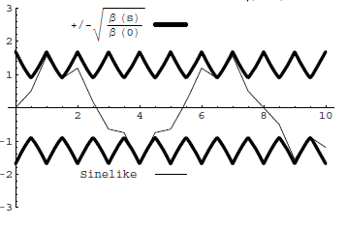
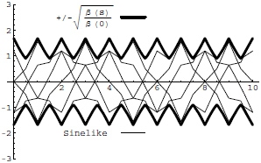
Conceptual understanding of β
It’s important to remember that the betatron function represents a bounding envelope to the beam motion, not the beam motion itself
Normalized particle trajectory
Trajectories over multiple turns
β(s) is also effectively the local wave number which determines the rate of phase advance
Closely spaced strong quads ➔ small β ➔ small aperture, lots of wiggles
Sparsely spaced weak quads ➔ large β ➔ large aperture, few wiggles

Slide 39
Betatron Tune
Particle trajectory
As particles go around a ring, they will undergo a number of betatrons oscillations ν (sometimes Q) given by
This is referred to as the “tune”
Ideal orbit
We can generally think of the tune in two parts:
6.7
Integer : magnet/aperture optimization
Fraction: Beam Stability

Slide 40
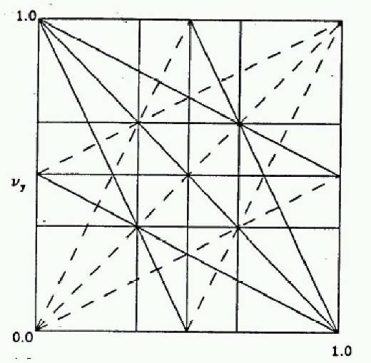
Tune, Stability, and the Tune Plane
If the tune is an integer, or low order rational number, then the effect of any imperfection or perturbation will tend be reinforced on subsequent orbits.
When we add the effects of coupling between the planes, we find this is also true for combinations of the tunes from both planes, so in general, we want to avoid
Many instabilities occur when something perturbs the tune of the beam, or part of the beam, until it falls onto a resonance, thus you will often hear effects characterized by the “tune shift” they produce.
“small” integers
➔Avoid lines in the “tune plane”
fract. part of Y tune
fract. part of X tune

Slide 41
Characterizing an Ensemble: Emittance
If each particle is described by an ellipse with a particular amplitude, then an ensemble of particles will always remain within a bounding ellipse of a particular area:
Area = ε
Either leave the π out, or include it explicitly as a “unit”. Thus
microns (CERN) and
π-mm-mr (FNAL)
Are actually the same units (just remember you’ll never have to explicity use π in the calculation)
These are really the same

Slide 42
Definitions of Emittance
Because distributions normally have long tails, we have to adopt a convention for defining the emittance. The two most common are
Gaussian (electron machines, CERN):
95% Emittance (FNAL):
In general, emittance can be different in the two planes, but we won’t worry about that.

Slide 43
Emittance and Beam Distributions
As we go through a lattice, the bounding emittance remains constant
large spatial distribution
small angular distribution
small spatial distribution
large angular distribution

Slide 44
Adiabatic Damping
In our discussions up to now, we assume that all fields scale with momentum, so our lattice remains the same, but what happens to the ensemble of particles? Consider what happens to the slope of a particle as the forward momentum incrementally increases.
If we evaluate the emittance at a point where α=0, we have
“Normalized emittance”
=constant!

Slide 45
Consequences of Adiabatic Damping
As a beam is accelerated, the normalized emittance remains constant
Actual emittance goes down down
Which means the actual beam size goes down as well
The angular distribution at an extremum (α=0) is
We almost always use normalized emittance
betatron function
RMS emittance
95% emittance
v/c

Slide 46
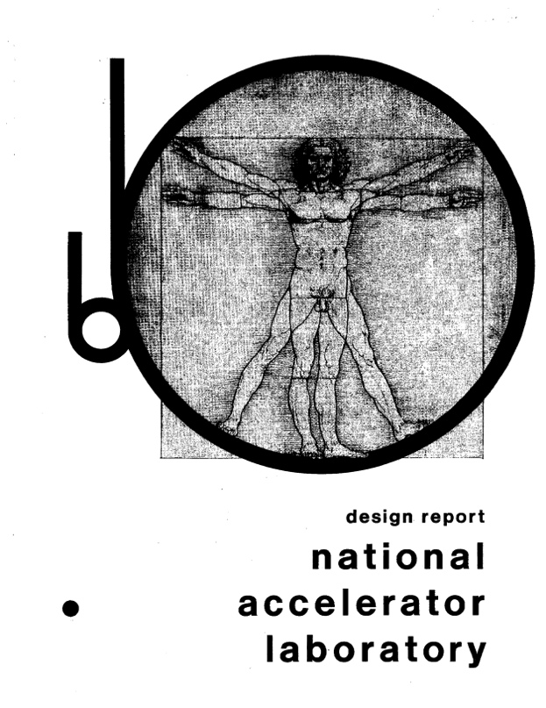
Example: Fermilab Main Ring
First “separated function” lattice
1 km in radius
First accelerated protons from 8 to 400 GeV in 1972
1968

Slide 47
Beam Parameters
The Main Ring accelerated protons from kinetic energy of 8 to 400 GeV*
Parameter | Symbol | Equation | Injection | Extraction
proton mass | m [GeV/c²] |  | 0.93827
kinetic energy | K [GeV] |  | 8 | 400
total energy | E [GeV] |  | 8.93827 | 400.93827
momentum | p [GeV/c] |  | 8.88888 | 400.93717
rel. beta | β |  | 0.994475 | 0.999997
rel. gamma | γ |  | 9.5263 | 427.3156
beta-gamma | βγ |  | 9.4736 | 427.3144
rigidity | (Bρ) [T-m] |  | 29.65 | 1337.39
*remember this for problem set

Slide 48
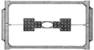
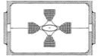
Cell Parameters
From design report
L=29.74 m
Phase advance μ=71°
Quad Length l_{quad}=2.13 m
Beta functions (slide 36)
Magnet focal length
Quad gradient (slide 12)

Slide 49
Beam Line Calculation: MAD
We could calculate α(s),β(s), and γ(s) by hand (slide 25) , but…
There have been and continue to be countless accelerator modeling programs; however MAD (“Methodical Accelerator Design”), started in 1990, continues to be the “Lingua Franca”
98.4m (exact) vs. 99.4m (thin lens)
main_ring.madx
!
! One FODO cell from the FNAL Main Ring (NAL Design Report, 1968)
!
beam, particle=proton,energy=400.938272,npart=1.0E9;
LQ:=1.067;
LD:=29.74-2*LQ;
qf: QUADRUPOLE, L=LQ, K1=.0195;
d: DRIFT, L=LD;
qd: QUADRUPOLE, L=LQ, K1=-.0195;
fodo: line = (qf,d,qd,qd,d,qf);
use, period=fodo;
match,sequence=FODO;
SELECT,FLAG=SECTORMAP,clear;
SELECT,FLAG=TWISS,column=name,s,betx,alfx,bety,alfy,mux,muy;
TWISS,SAVE;
PLOT,interpolate=true,,colour=100,HAXIS=S, VAXIS1=BETX,BETY;
PLOT,interpolate=true,,colour=100,HAXIS=S, VAXIS1=ALFX,ALFY;
stop;
half quad
K1=1/(2f)
24.7m vs. 26.4m
build FODO cell
force periodicity
calculate Twiss parameters

Slide 50
Beam Sizes
We normally use 95% emittance at Fermilab, and 95% normalized emittance of the beam going into the Main Ring was about 12 π-mm-mr, so the normalized RMS emittance would be
We combine this with the equations (slide 45), beam parameters (slide 47) and lattice functions (slide 48) to calculate the beam sizes at injection and extraction.
We have divided out the “π”
Parameter | Symbol | Equation | Injection | Extraction
kinetic energy | K [GeV] |  | 8 | 400
beta-gamma | βγ |  | 9.4736 | 427.3144
normalized emittance |  |  | 2x10⁻⁶
beta at QF |  |  | 99.4
beta at QD |  |  | 26.4
x size at QF |  |  | 4.58 |  | .68
y size at QF |  |  | 2.36 |  | .35
x ang. spread at QF |  |  | 46.1x10⁻⁶ |  | 6.9x10⁻⁶
y ang. spread at QF |  |  | 89.5x10⁻⁶ |  | 13.3x10⁻⁶

Slide 51
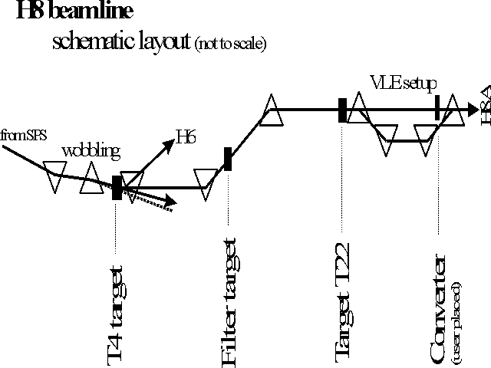
Beam Lines
In our definition and derivation of the lattice function, a closed path through a periodic system. This definition doesn’t exist for a beam line, but once we know the lattice functions at one point, we know how to propagate the lattice function down the beam line.

Slide 52
Establishing Initial Conditions
When extracting beam from a ring, the initial optics of the beam line are set by the optics at the point of extraction.
For particles from a source, the initial lattice functions can be defined by the distribution of the particles out of the source

Slide 53
Modeling FODO Cells in g4beamline
In spite of the name, g4beamline is not really a beam line tool.
Does not automatically handle recirculating or periodic systems
Does not automatically determine reference trajectory
Does not match or directly calculate Twiss parameters
Fits particle distributions to determine Twiss parameters and statistics.
Nevertheless, it’s so easy to use, that we can work around these shortcomings
Create a series of FODO cells
Carefully match our initial particle distributions to the calculations we just made.

Slide 54
Creating a Line of FODO Cells
We’ve calculated everything we need to easily create a string of FODO cells based on the Main Ring
Won’t worry about bends
Phase advance per cell = 71°, so need at least at least ~5 cells to see one betatron period. Let’s do 8.
First, create a quadrupole
# Main Ring FODO cell
param L=29740.
param QL=2133.3
param aperture=50. # Not really important
param -unset gradient=24.479
param -unset nCell=8
genericquad MRQuad fieldLength=$QL ironLength=$QL apertureRadius=$aperture ironRadius=5*$aperture kill=1
kill=1 saves time if you make a mistake!
Doesn’t really look like a real quadrupole, but the field is right and that’s all that matters.

Slide 55
Create string of FODOs
Create 8 cells by putting 16 of these, spaced 29740 mm apart, with alternating gradients (good practice for doing loops in g4bl).
If we put the first quad at z=0., the beam will start the middle of it. Is this what we want? Why or why not?
We create a Gaussian beam based on the parameters we calculated on Slide 50
We want to track the first hundred particles individually, so we add
We want to fit the distributions at regular intervals to calculate the beam widths and Twiss parameters. so we add the lines
Now run 1000 events
Need enough for robust fits
beam gaussian sigmaX=.682 sigmaXp=.00000686 sigmaY=.351 sigmaYp=.00001332 \
meanMomentum=$P nEvents=$nEvents particle=proton
trace nTrace=100 oneNTuple=1 primaryOnly=1
param totlen=2*$nCell*$L
profile zloop=0:$totlen:100 particle=proton file=main_ring_profile.txt

Slide 56
Analyze Output
The individual track information is written to the standard root output file in an Ntuple called “AllTracks”
The profile information is written to a text file. This can be read directly into histoRoot. I’ve provided a class (G4BLProfile) to load it into root*
We want to create a plotting space on which we can overlay several plots. The easiest way I know do to this is an empty 2D histogram.
Overlay a 3 sigma “envelope”, based on the fitted profiles
TFile ft("g4beamline.root");
TNtuple *t = (TNtuple *) ft.FindObjectAny("AllTracks");
G4BLProfile fp(filename);
TNtuple *p = fp.getNtuple();
TH2F plot("plot","Track Trajectories",2,0,sMax,2,-xMax,xMax);
plot.SetStats(kFALSE); //turn off annoying stats box
plot.Draw();
p->Draw("3*sigmaX:Z","","same");
p->Draw("-3*sigmaX:Z","","Same");
“same” option draws over existing plot
*http://home.fnal.gov/~prebys/misc/NIU_Phys_790/

Slide 57
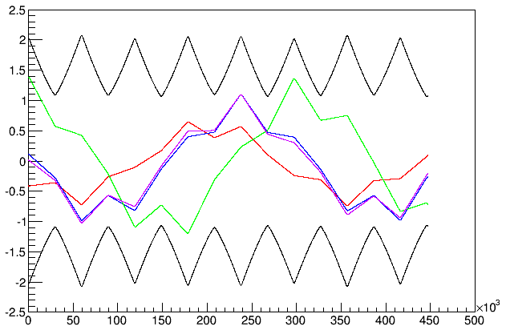
Plot Individual Tracks
t->SetMarkerColor(kRed); // These are points, not lines
t->Draw("x:z","EventID==1","same");
...

Slide 58
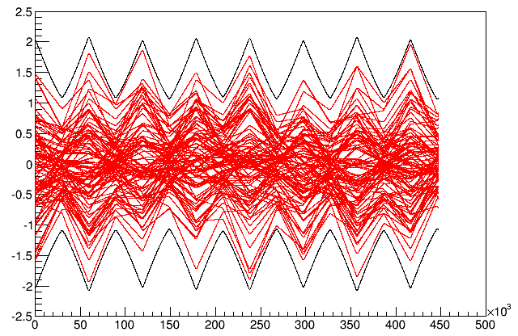
Envelopes
If we overlay all 100 tracks (remove “EventID” cut), we see that although each track has a periodicity of ~5 cells, the envelope has a periodicity of one cell..

Slide 59
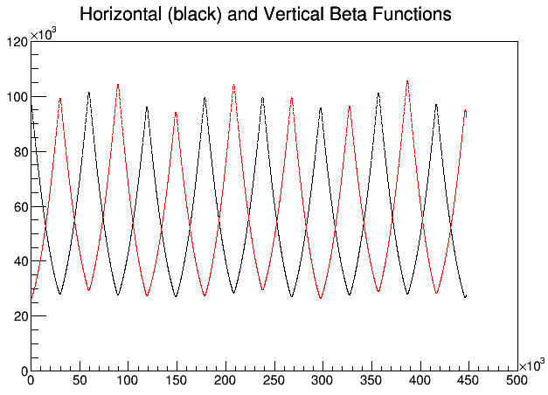
Lattice Functions
We can plot the fitted lattice functions and compare them to our calculations.
TH2F beta("beta","Horizontal (black) and Vertical Beta Functions",2,0.,sMax,2,0.,120000.);
beta.SetStats(kFALSE);
beta.Draw();
p->Draw("betaX:Z","","same");
p->SetMarkerColor(kRed);
p->Draw("betaY:Z","","same");
beta functions in mm!
slight mismatch because of thin lens approximation

Slide 60
Mismatch and Emittance Dilution
In our previous discussion, we implicitly assumed that the distribution of particles in phase space followed the ellipse defined by the lattice function
Once injected, these particles will follow the path defined by the lattice ellipse, effectively increasing the emittance
Lattice ellipse
…but there’s no guarantee
What happens if this it’s not?
Area = ε
Injected particle distribution
Effective (increased) emittance

Slide 61
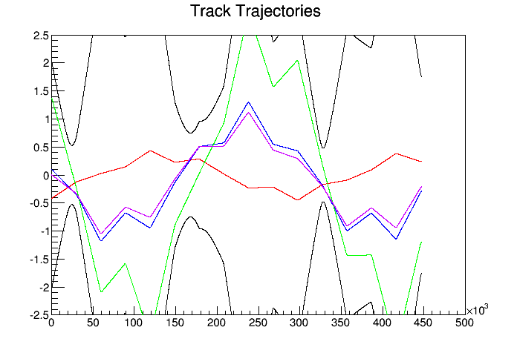
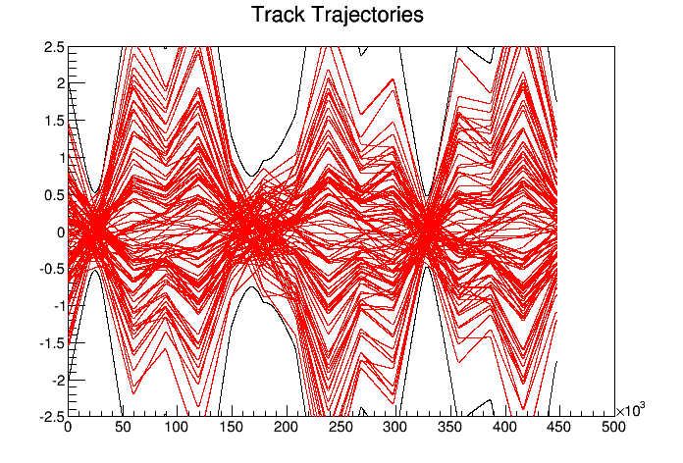
How Important is Matching?
In our example, we carefully matched our initial distributions to the calculated lattice parameters at the center of the magnet. If we start these same distributions just ~1m upstream, at the entrance to the magnet, things aren’t so nice.
Individual track trajectories look similar (of course)
Envelope looks totally crazy

Slide 62
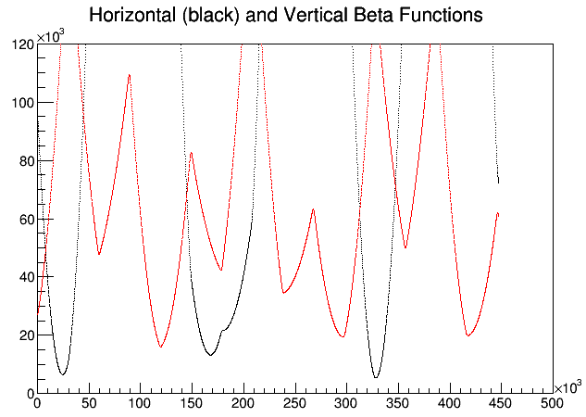
Effect of Mismatching on Lattice Parameters
If we fit the beta functions of these distributions, we see that the original periodicity is completely lost now.
Therefore, lattice matching is very important when injecting, extracting, or transitioning between different regions of a beam line!

Slide 63
Problem Set: Large Hadron Collider (LHC)
Built at CERN, straddling the French/Swiss border
27 km in circumference
Started in 2008, broke, started again in 2010
Has collided two proton beams at 4000 GeV each
In 2015, will reach design energy of 7000 GeV/beam (~7 x Fermilab Tevatron)

Slide 64
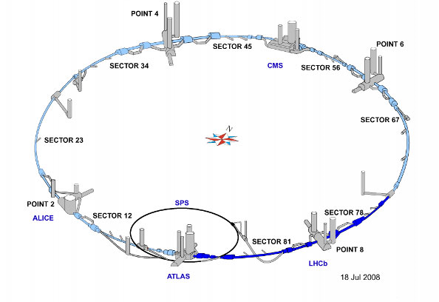
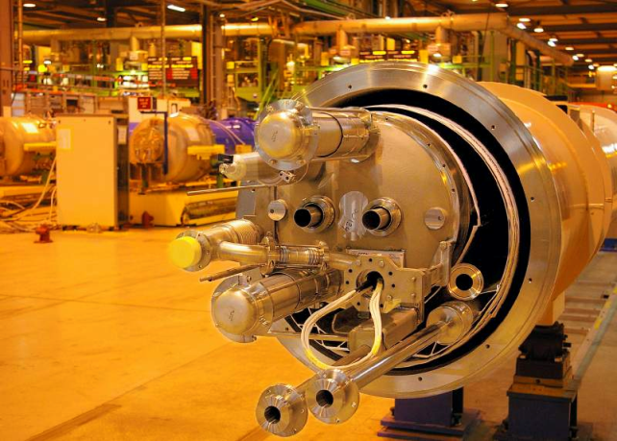
LHC Layout and Numbers
Design:
7 TeV+7 TeV proton beams
Can’t make enough antiprotons for the LHC
Magnets have two beam pipes, one going in each direction.
Stored beam energy 150 times more than Tevatron
Each beam has only 5x10⁻¹⁰ grams of protons, but has the energy of a train going 100 mph!!
These beams are focused to a size smaller than a human hair to collide with each other!
27 km in circumference
2 major collision regions: CMS and ATLAS
2 “smaller” regions: ALICE and LHCb

Slide 65
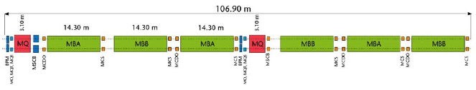
Standard LHC FODO Cell
e⁺e⁻ or proton-antiproton (opposite charge) colliders had particles going in opposite directions in the same beam pipe
Because the LHC collides protons (same charge), the magnets have two apertures with opposite fields
quadrupoles
dipoles (B_{max} = 8.3 T)
Problem set is just our in class example with different numbers.

